Slide 1
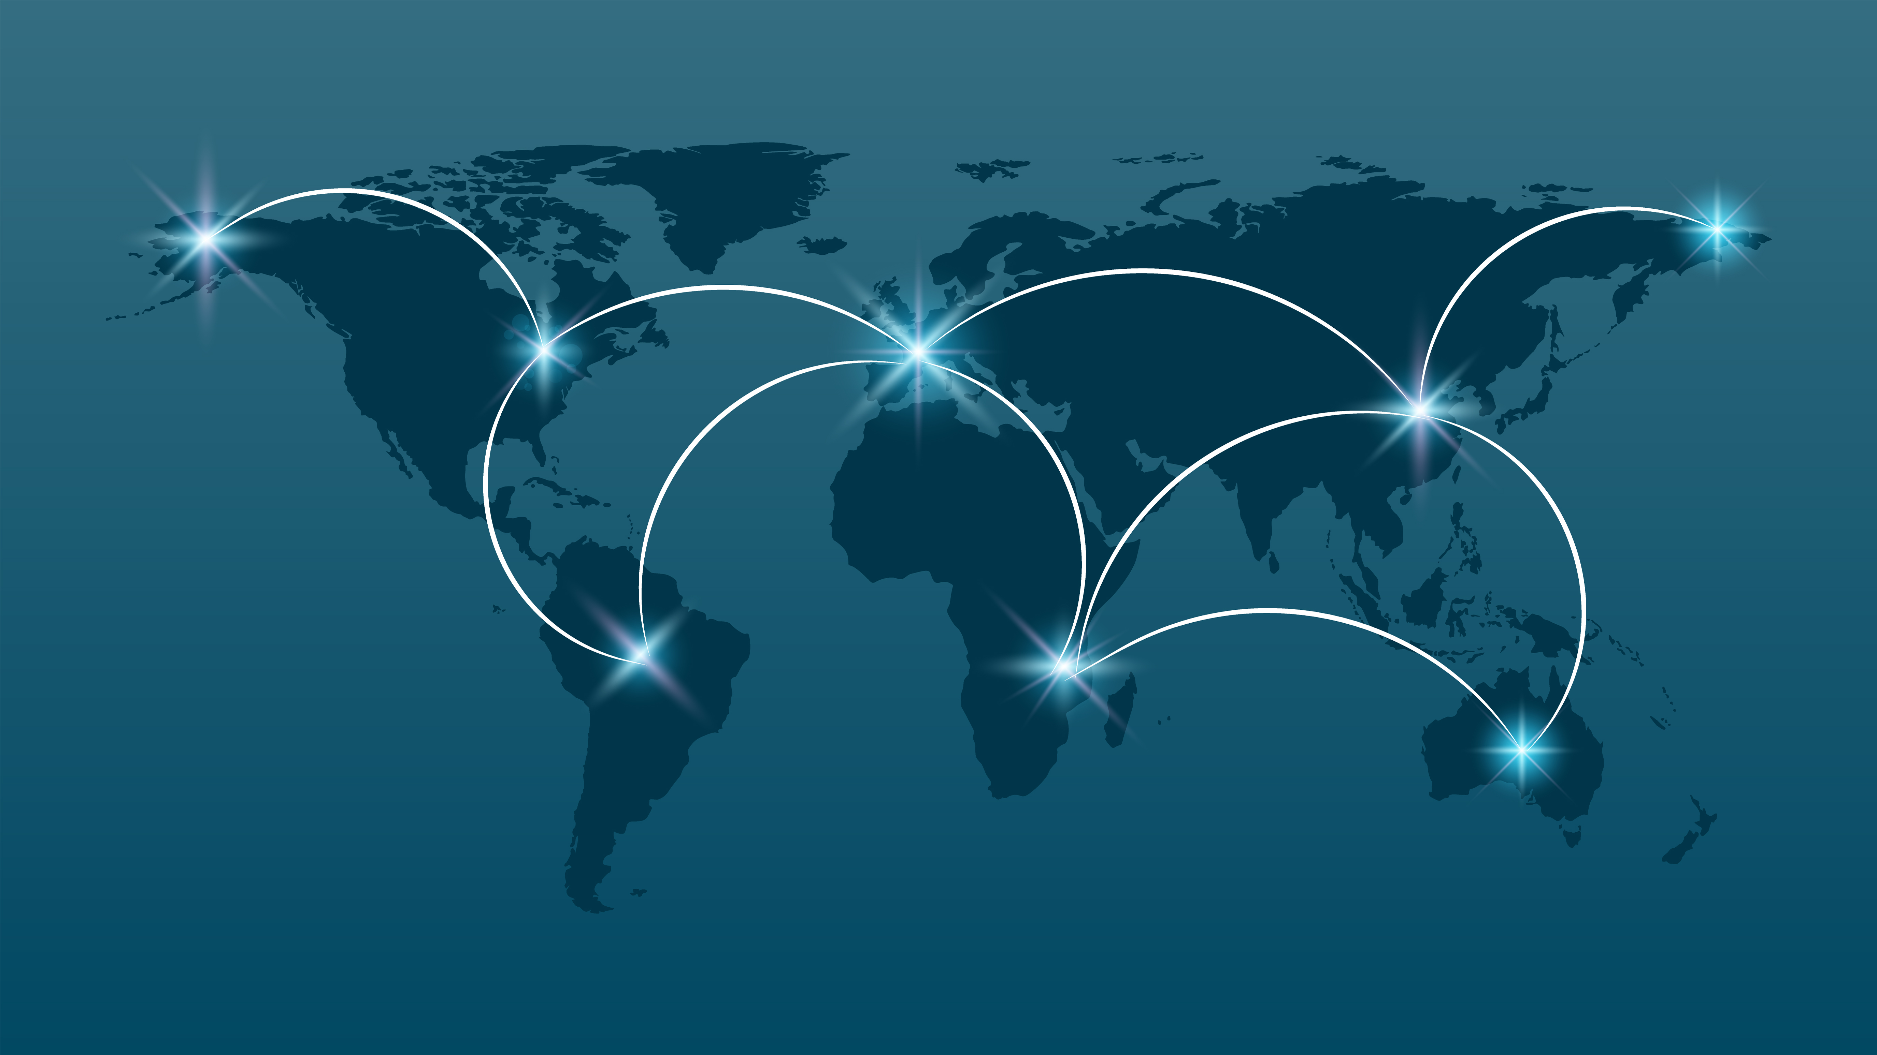
Project 3: Visualising World Connectivity
Project Team Members: Khadra, Chisimnulia, Kudzanai and Nathaniel.

Slide 2
Data Extraction:
Screeshot of data files
After deciding on the topic we wanted to visualise we extracted our data from the following sources:
World Bank database: https://data.worldbank.org/indicator/it.net.user.zs (CSV file)
ITU (UN specialised agency for information and communications technologies): :https://www.itu.int/en/ITU-D/Statistics/Pages/facts/default.aspx (Excel files)

Slide 3
Data Transformation:
Screenshot of jupyter notebook
We then transformed the extracted csv and excel files with Python using Pandas Jupyter notebook. Finally, we turned our data cleaning steps into a function for the next step.

Slide 4
Data Loading
App.py/databse screenshot
We used the function in the previous step to clean data and load it onto our PGAdmin database using Flask-powered API and made this database online accessible with Heroku.

Slide 5
Data Visualisations
Screen shots of dashboard charts
Connectivity Dashboard was created using the following
JS libraries:
Maps: D3/Leaflet.js was used to visualise internet and phone usage around the world.
Charts and Graphs: HighChart.js was used to visualise the region and demographics internet and phone usage data.

Slide 6
Connectivity Dashboard
Screenshot of the dashboard

Slide 7
Connectivity Dashboard
Screenshot of the dashboard

